Slide 1


NPDES Phase II MS4 Annual Public Meeting
Joseph Wilk, PE
Christopher B. Burke Engineering, Ltd.

Slide 2
What is NPDES?
National Pollutant Discharge Elimination System
Permit program controls water pollution by regulating point sources that discharge pollutants into waters of the United States (construction sites, WWTP, industrial sites, municipalities)
      United States Environmental Protection Agency program administered by the Illinois EPA.
      Lincolnwood NPDES MS4 General Permit

Slide 3
What is an MS4?
Municipal Separate Storm Sewer System
A conveyance or system of conveyance within a state, city, or other public entity that discharges to waters of the United States:
      Designed or used for collecting storm water;
      Not related to sanitary sewer system
      Collection of point sources that discharge to streams
Notes:
An MS4 is a not the community, but the conveyance system that services the community.
Therefore components of an MS4 may be storm sewers, manholes, curbs, gutters, inlets, ditches, swales, and detention and retention ponds.

Slide 4
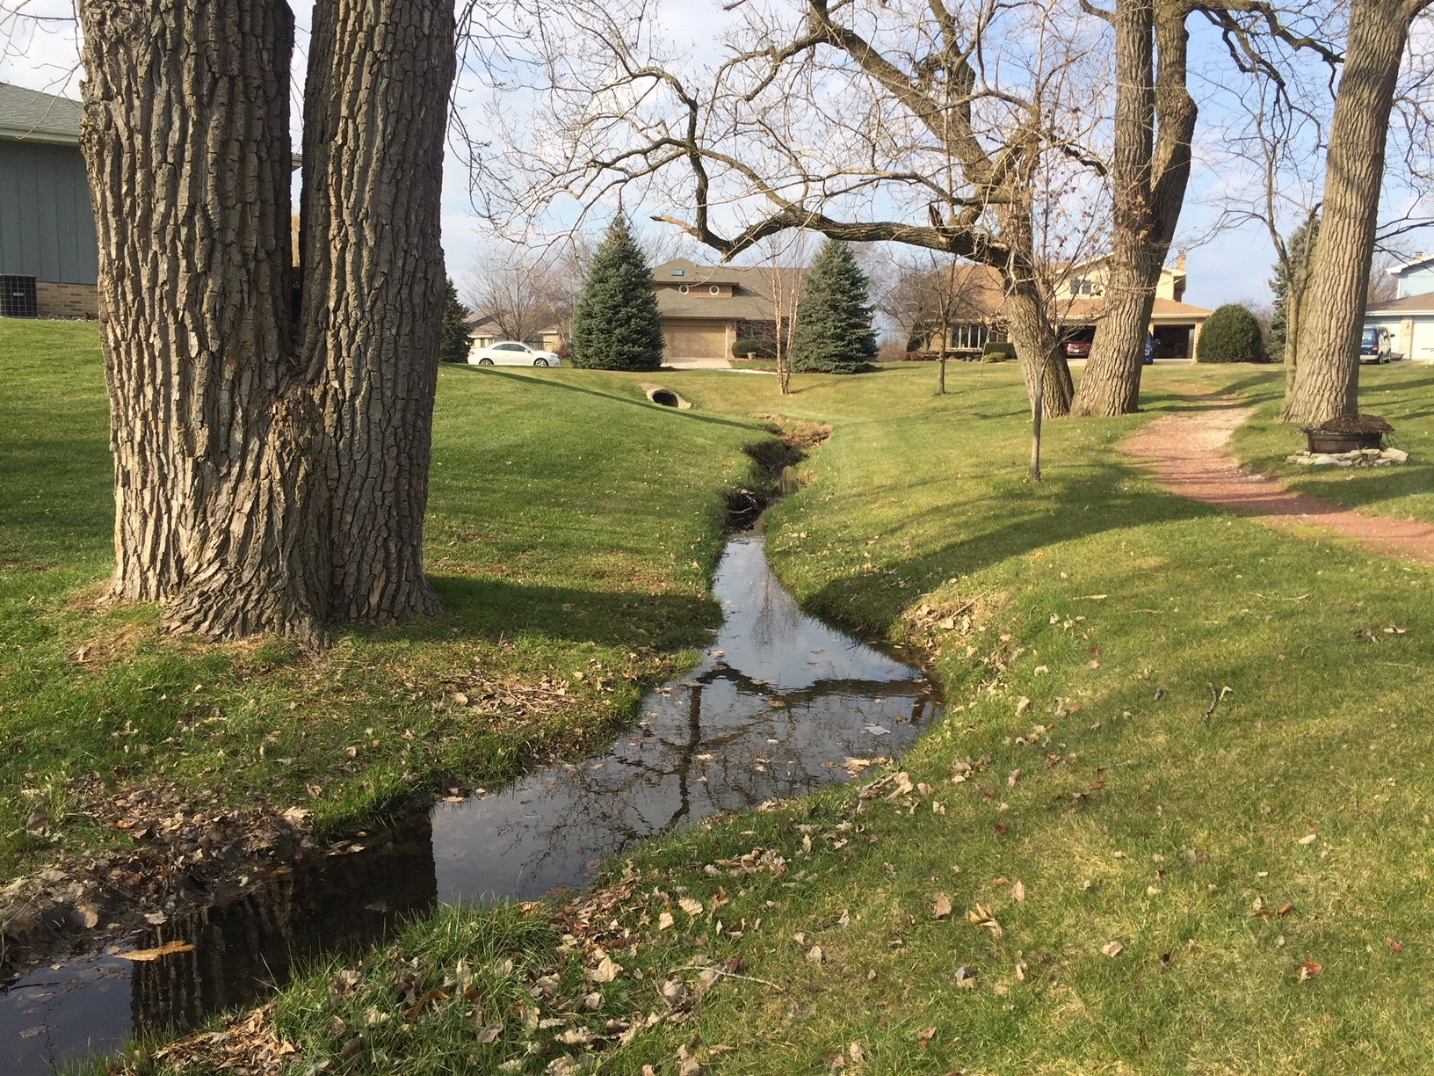
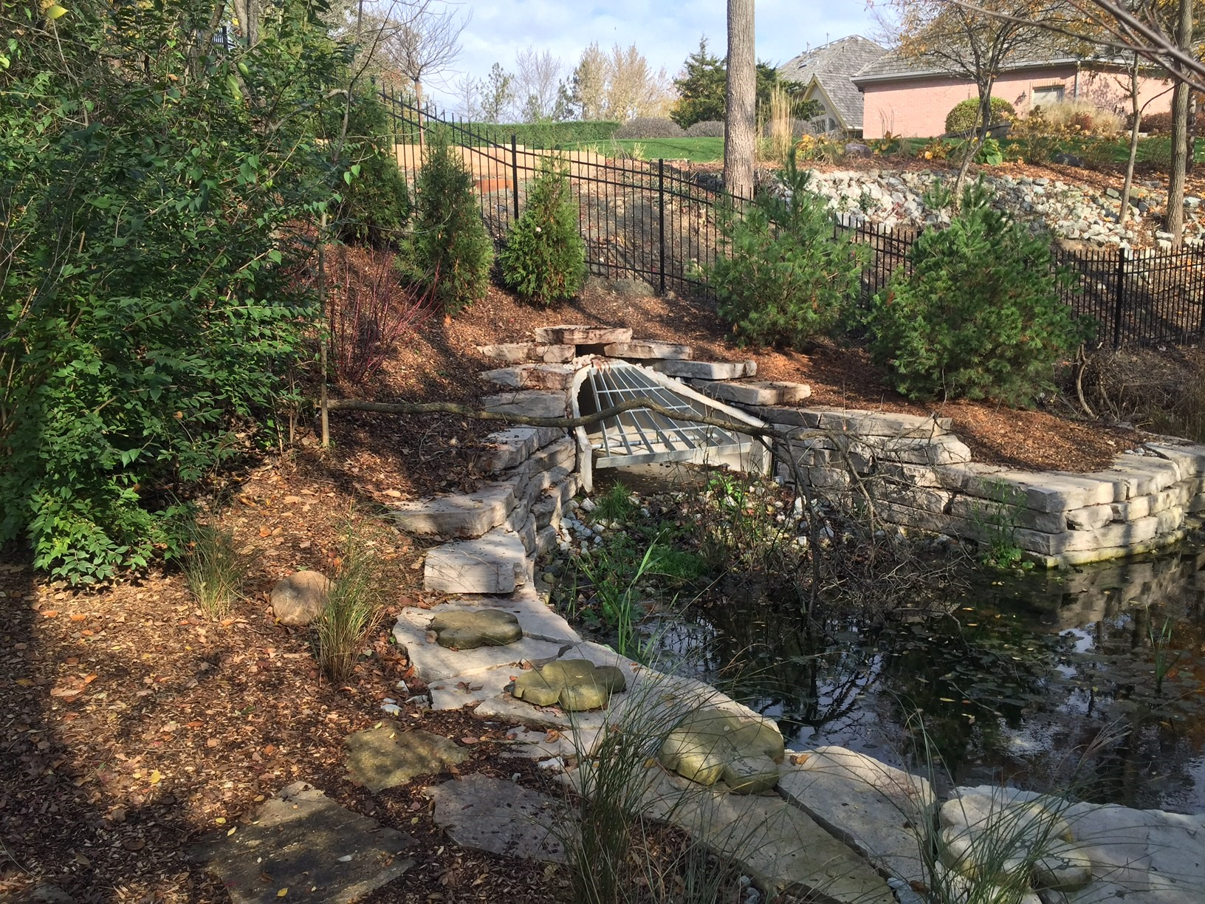
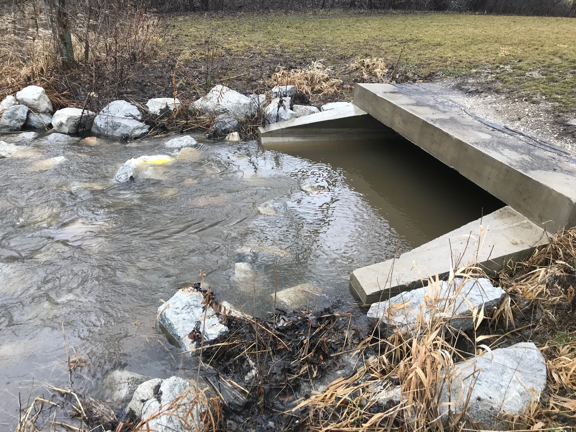
What are point sources?
A point source is defined by the EPA as:
“any discernible, confined and discrete conveyance, including but not limited to any pipe, ditch, channel, tunnel, conduit, well, discrete fissure, container, rolling stock, concentrated animal feeding operation, or vessel or other floating craft, from which pollutants are or may be discharged.”
Notes:
An MS4 is a not the community, but the conveyance system that services the community.
Therefore components of an MS4 may be storm sewers, manholes, curbs, gutters, inlets, ditches, swales, and detention and retention ponds.

Slide 5
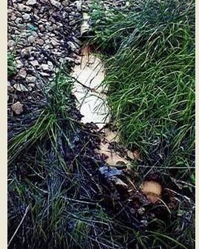
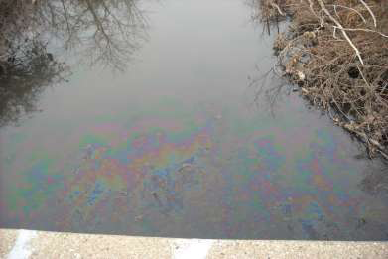
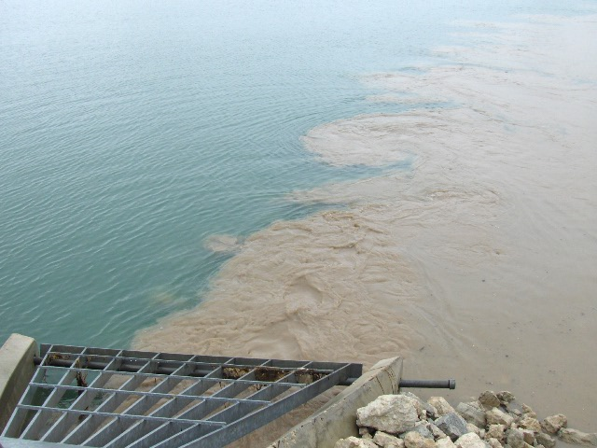
And why are they important?
Point sources introduce contaminants such as chemicals, toxins, sediment directly to local streams, rivers, wetlands and other local waterbodies
Notes:
An MS4 is a not the community, but the conveyance system that services the community.
Therefore components of an MS4 may be storm sewers, manholes, curbs, gutters, inlets, ditches, swales, and detention and retention ponds.

Slide 6
Receiving Stream
  North Shore Channel Watershed

Slide 7
Stormwater Management
Program Plan (SMPP)
Required to develop a SMPP comprised of BMPs and measurable goals for each of the following six minimum control measures:
Public education and outreach on storm water impacts
Public involvement and participation
Illicit discharge detection and elimination
Construction site storm water runoff control
Post construction storm water management in new development and redevelopment
Pollution prevention/good housekeeping for municipal operations

Slide 8
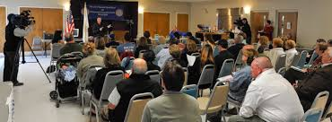
Permit Requirements
One Public Stormwater Meeting per Year

Slide 9
Program Requirements
Village must regulate ALL discharges to the MS4
Construction Sites
Commercial Uses
Industrial Uses
Private Residences
Municipal Facilities and activities

Slide 10
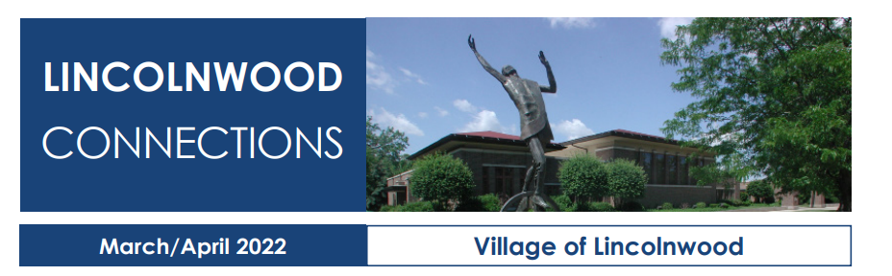
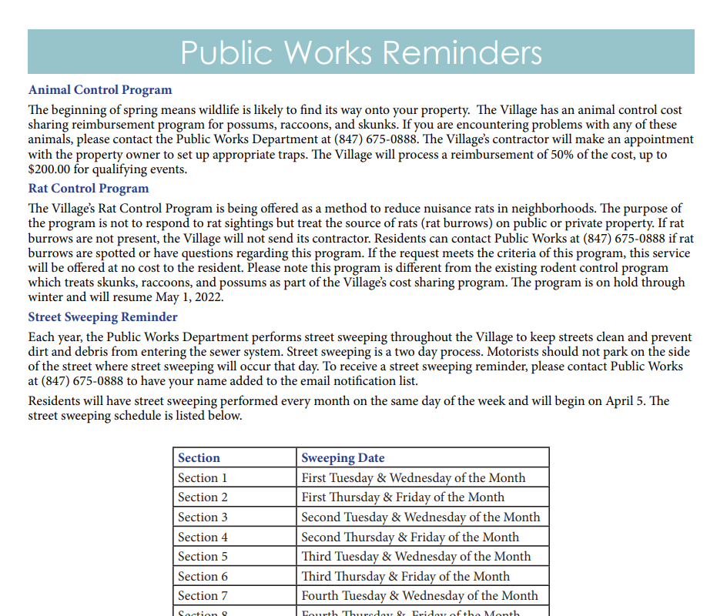
Public Education and Outreach
Stormwater or water quality information in newsletter

Slide 11
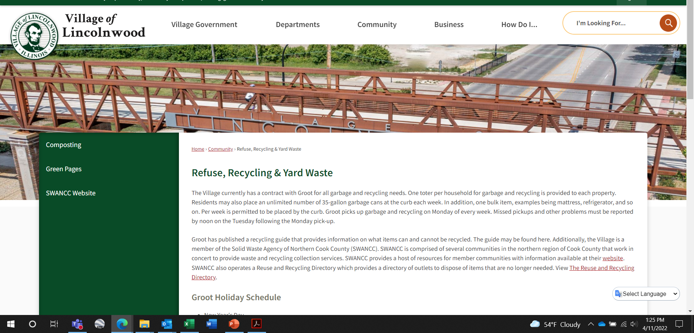
Public Education and Outreach
Information on Village website

Slide 12
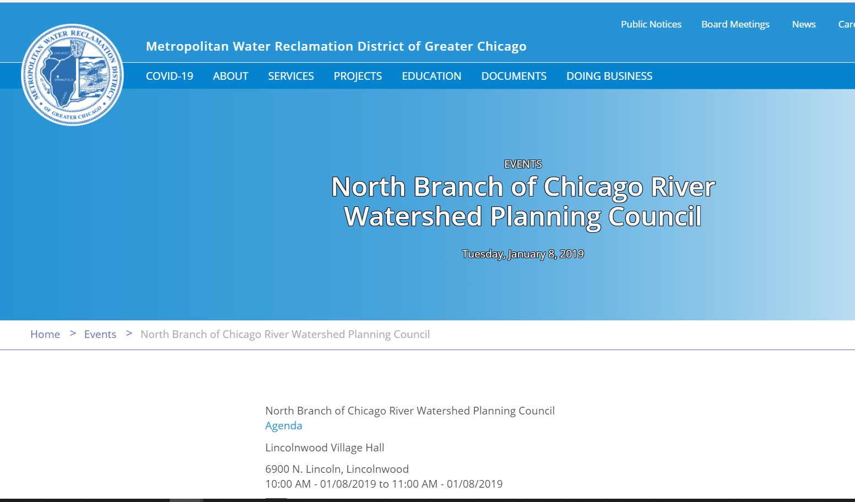
Public Participation and Involvement
Public meetings
North Branch of Chicago River Watershed Planning Council

Slide 13
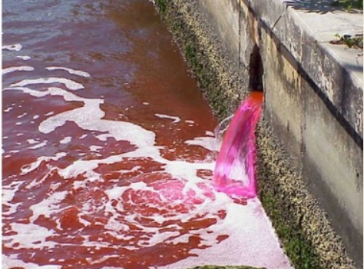
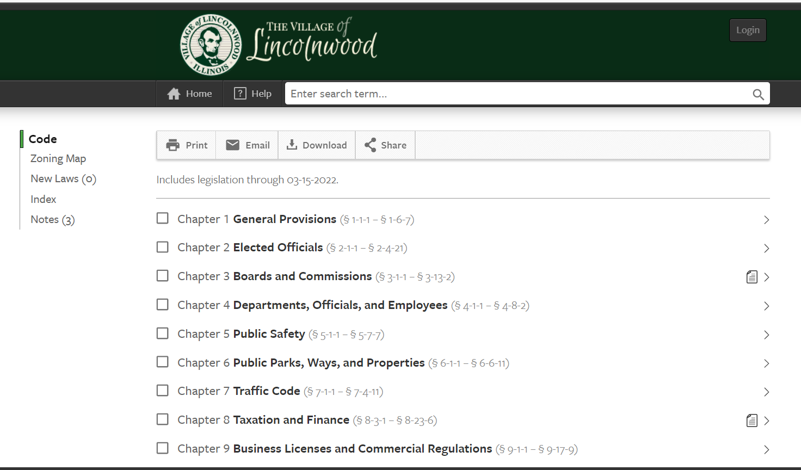
Illicit Discharge
Detection and Elimination
Storm Sewer Map
Code of Ordinances

Slide 14
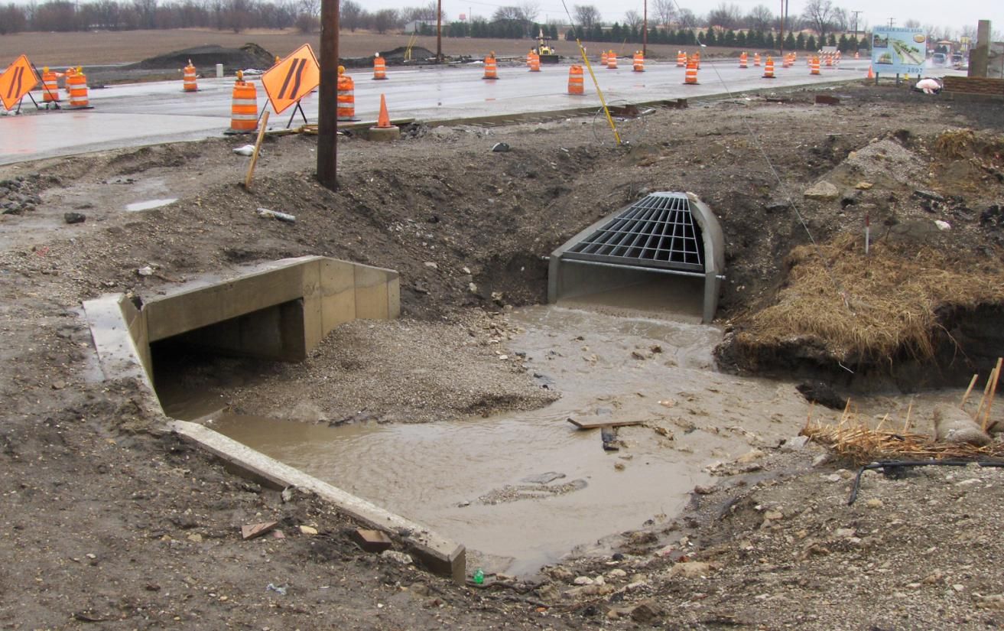
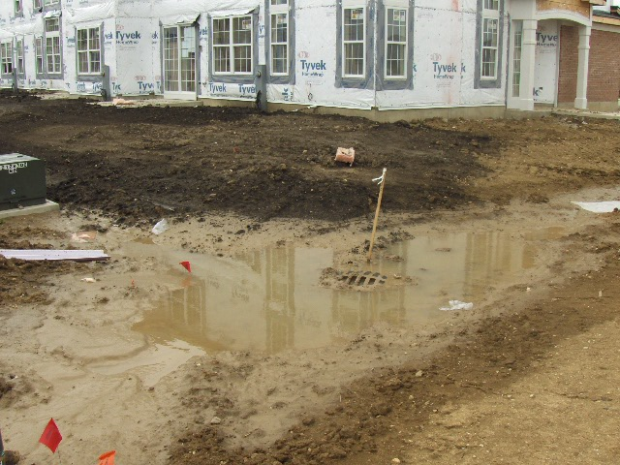
Construction Site
Runoff Control
Code of Ordinances
Inspection and enforcement procedures

Slide 15


Post Construction Site
Runoff Control
Plan review
Inspections

Slide 16
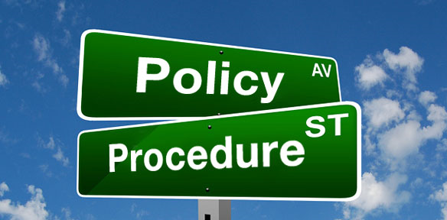

Pollution Prevention and
Good Housekeeping
Procedures or activities that municipalities and their employees can do to prevent or reduce stormwater contamination from municipal operations.

Slide 17
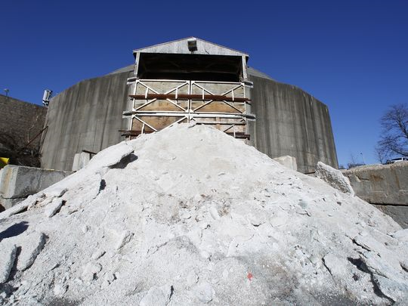
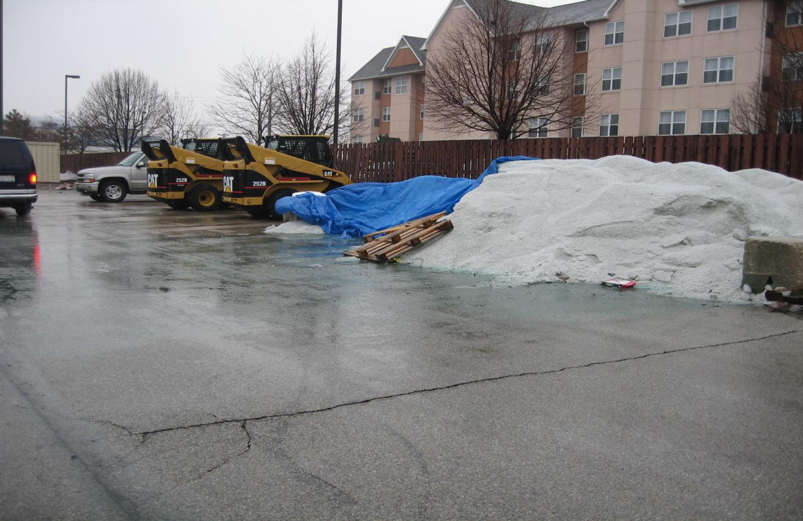
Pollution Prevention and
Good Housekeeping

Slide 18
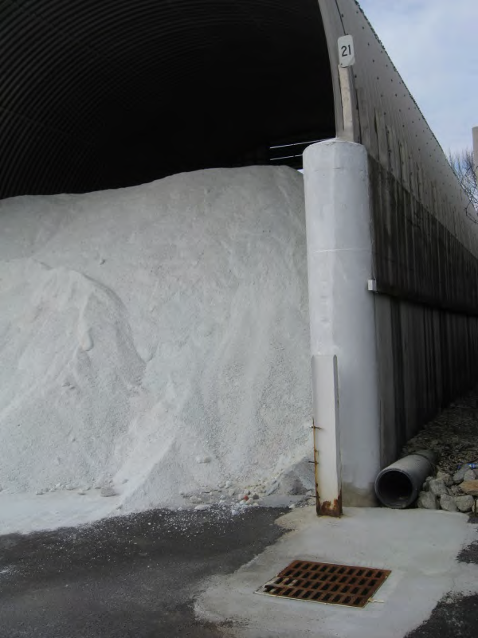
Pollution Prevention and
Good Housekeeping
8

Slide 19
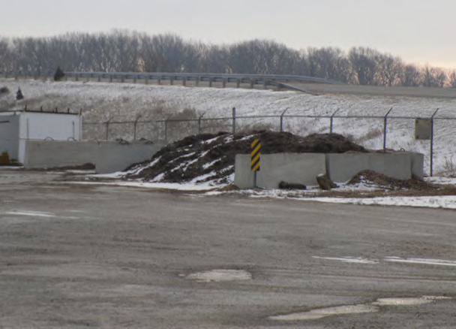
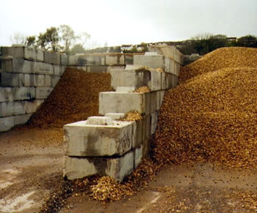
Pollution Prevention and
Good Housekeeping

Slide 20
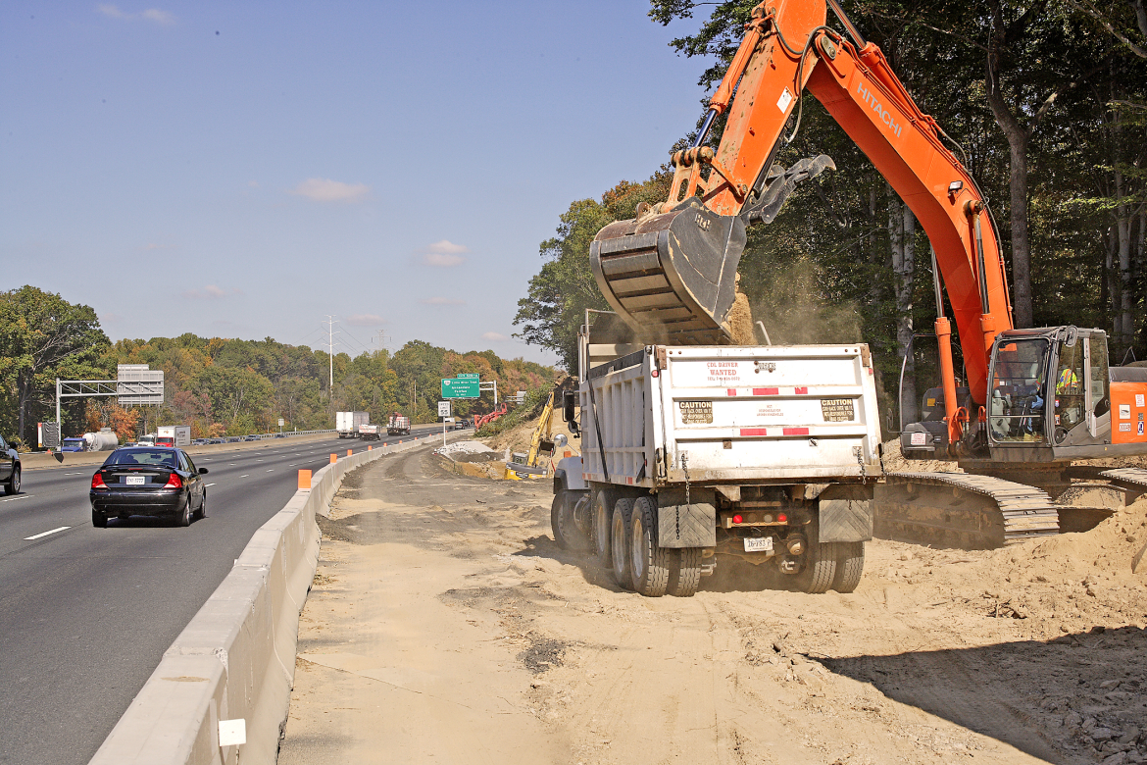
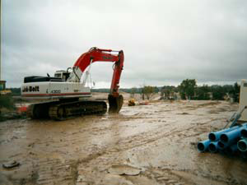
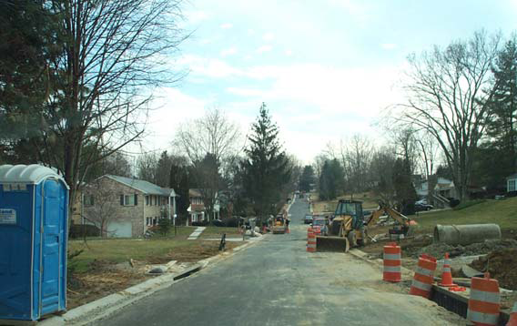
Pollution Prevention and
Good Housekeeping

Slide 21
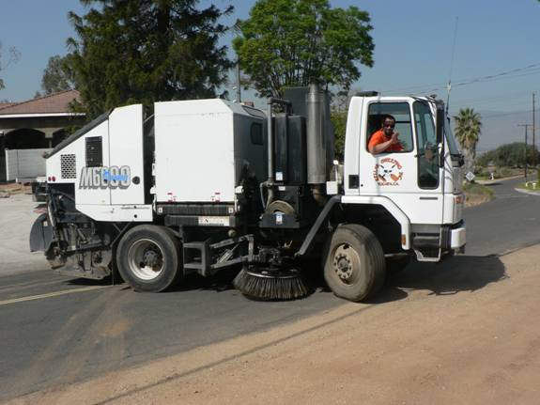
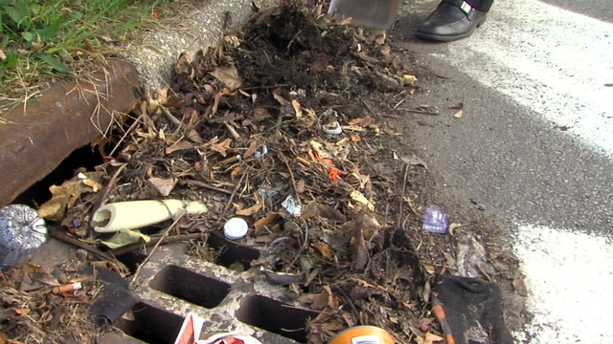
Pollution Prevention and
Good Housekeeping

Slide 22
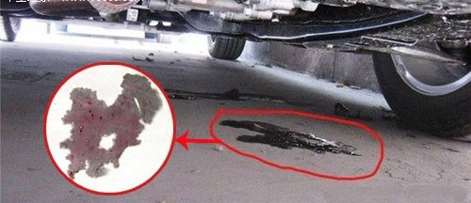
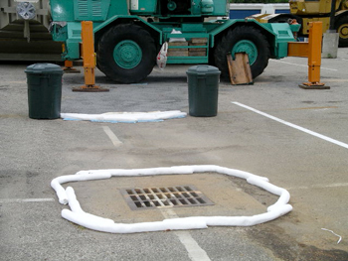
Pollution Prevention and
Good Housekeeping
8

Slide 23
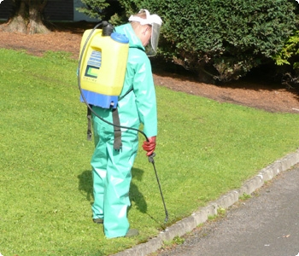
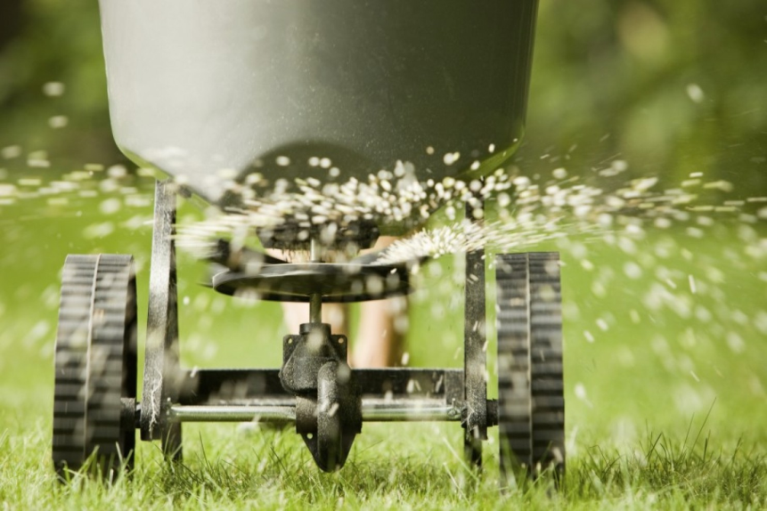

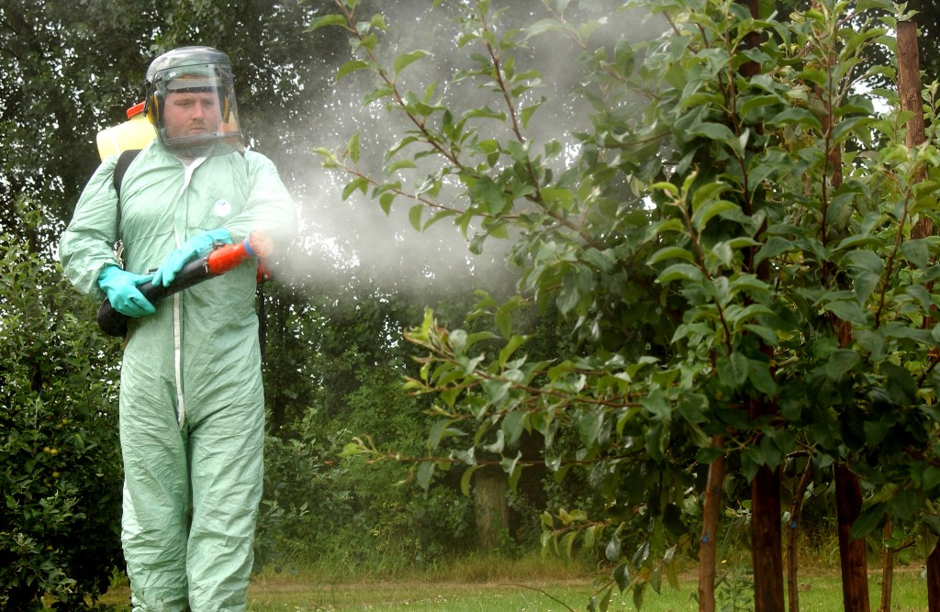
Pollution Prevention and
Good Housekeeping

Slide 24
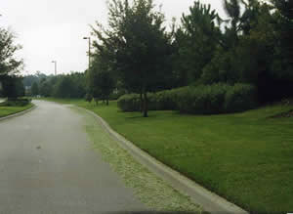
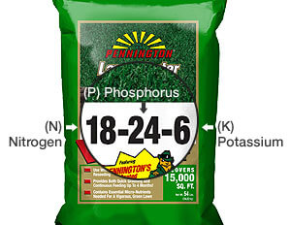
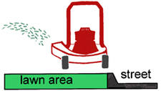
Pollution Prevention and
Good Housekeeping

Slide 25

Chicago Area Waterways Chloride Workgroup (CAWCW)
The Village will be joining the CAWCW as part of the Time Limited Water Quality Standard for Chloride permit requirement.
The workgroup assists municipalities in reducing chlorides in the waterways and aids members in completing items submitted to the IEPA
    Best Management Practices
    Pollutant Minimization Plan
    Annual Report

Slide 26
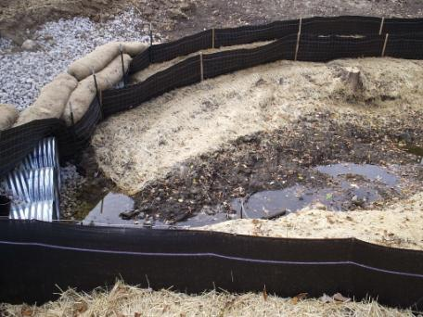
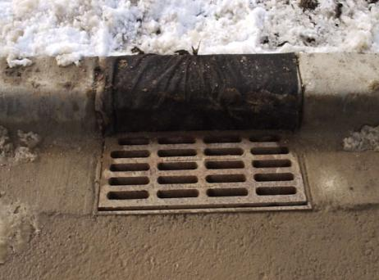
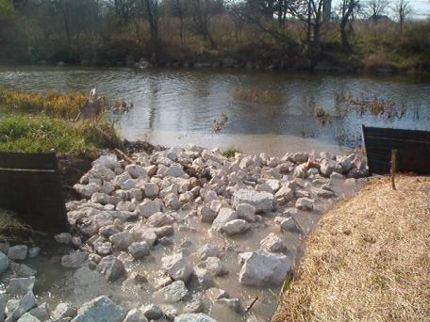
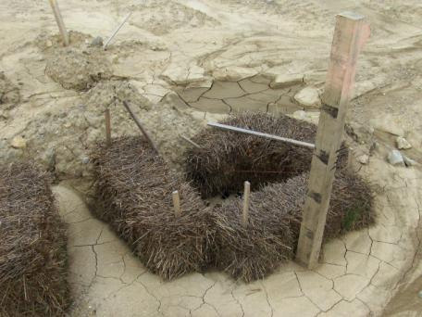
Questions ?

